Slide 1



COPRA AS
ALTERNATIVE FEEDS
FOR TILAPIA
Florence Ann Tomas and Christine Tolentino

Slide 2

WHY ARE
WE
HERE

Slide 3
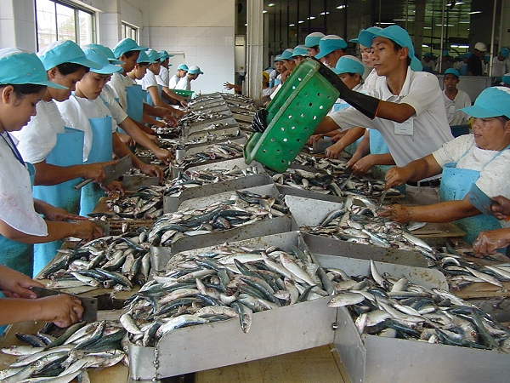
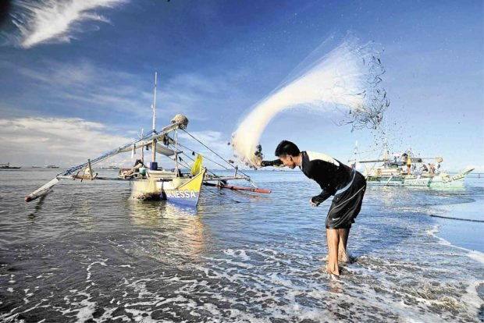
BARMM leads regions in fish production
258,981
metric tons of fish
and sea harvest
SOURCE: Inquirer.net ARMM leads regions in fish production

Slide 4
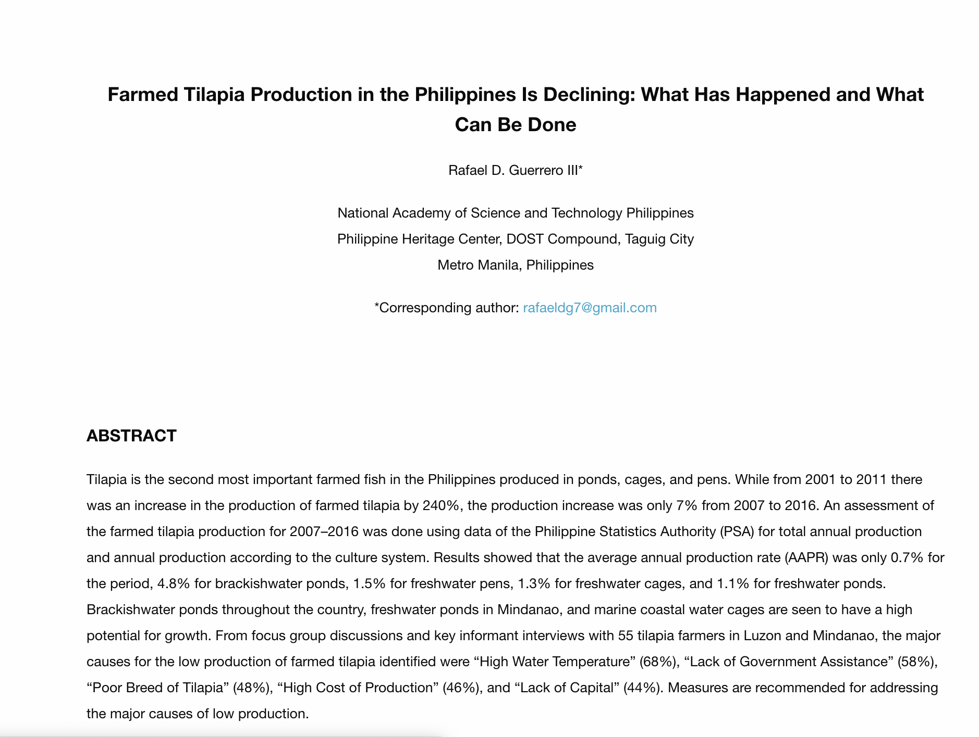
But! Just this Dec. 11,
Source: http://philjournalsci.dost.gov.ph/87-current-issue/vol-148-no-2-june-2019/1062-farmed-tilapia-production-in-the-philippines-is-declining-what-has-happened-and-what-can-be-done-2

Slide 5
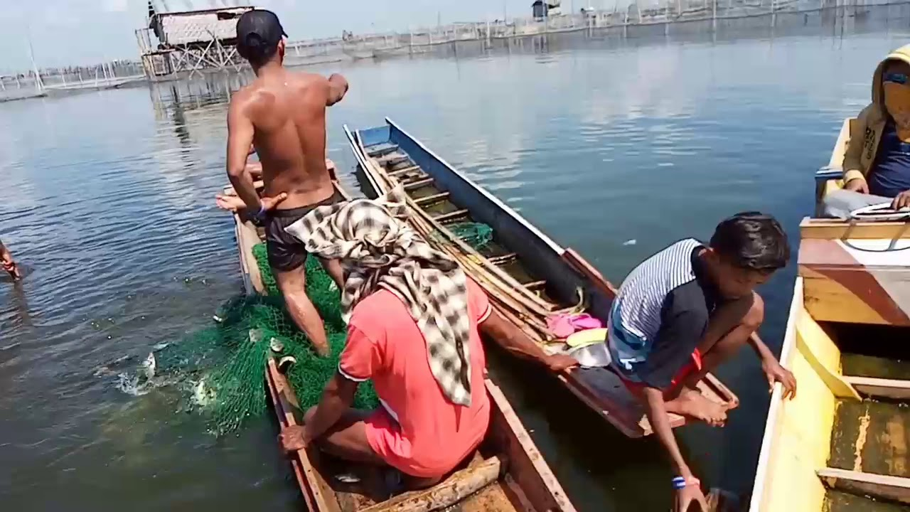

PROBLEM # 1
TILAPIA
5%
HARVEST FELL
BY MORE THAN
SOURCE: Inquirer.net ARMM leads regions in fish production

Slide 6

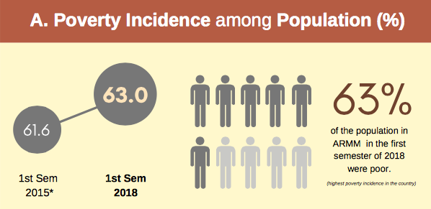

PROBLEM # 2
Source: Rappler Fast Facts: Poverty in Mindanao
Source: Philippine Statistics Authority as of 2019
Source: https://philippines.oxfam.org/tags/bangsamorohttps://philippines.oxfam.org/tags/bangsamoro

Slide 7


What's our
main
goal?

Slide 8
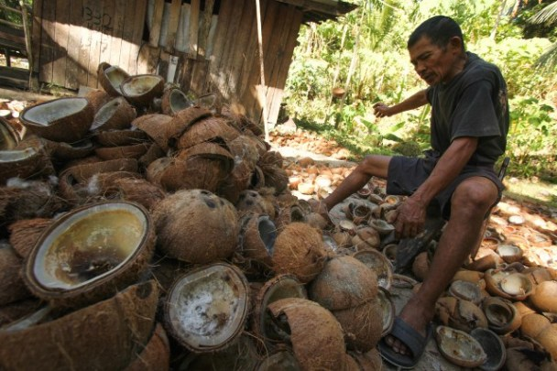
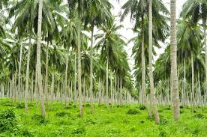
Where is BARMM rich in?
COCONUT
258, 599 hectares (19.85% of the total land area) and 324, 535 metric tons of copra
https://www.mindanews.com/top-stories/2017/11/portion-of-p75b-coco-levy-fund-will-be-set-aside-for-rd/
Source: Regional Physical Framework Plan, 2000-2030
https://philippinesexporttimes2015.wordpress.com/2015/04/14/
armms-coconut-industry-share-poor-quality-problems/
Notes:
1,460,409,218 nuts and

Slide 9
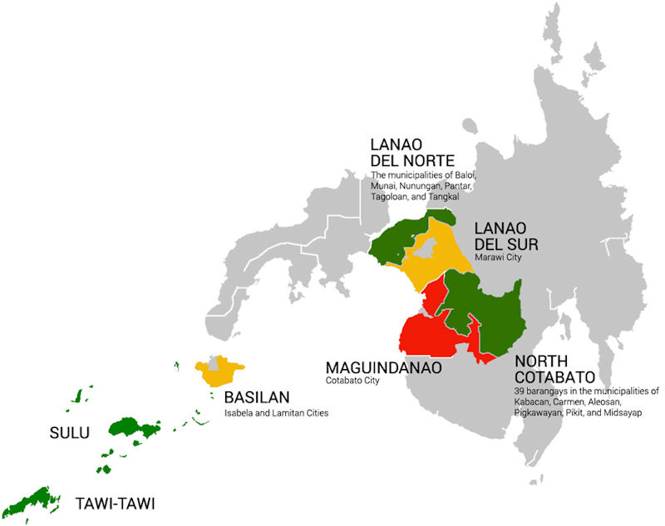


COCONUT IN DIFFERENT PROVINCES
Source: Philippine Statistics Authority as of 2018

Slide 10

Introducing our concept

Slide 11
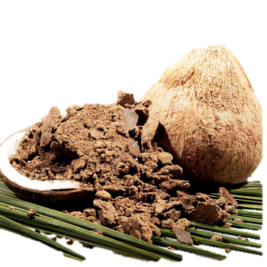
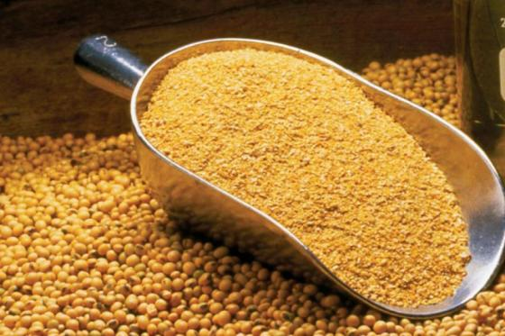

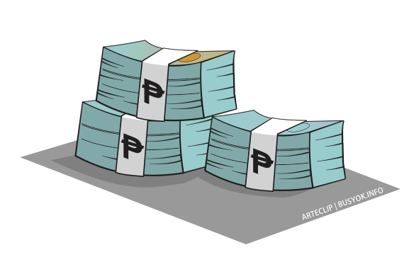




COPRA MEAL
SOY FEEDS
Php 18.00
Php 26 – 40
36 - 44% protein
40% protein
Local
Imported
Source:
DOST-PCAARD Protein enriched copra meal (PECM) as feed protein for tilapia, milkfish, and shrimp aquaculture
Nutrional value of soybean meal

Slide 12

TILAPIA FISHING PENS
Source: Regional Physical Framework Plan, 2000-2030

Slide 13


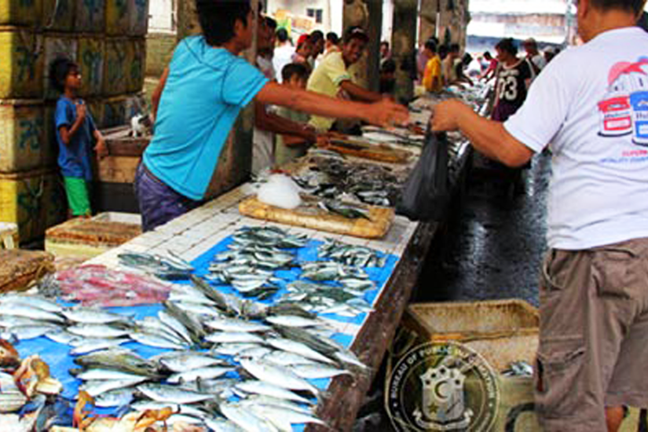
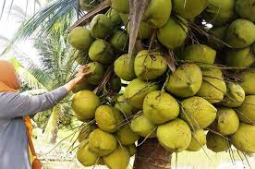
Solving Poverty by Entrepreneurship

